Slide 1
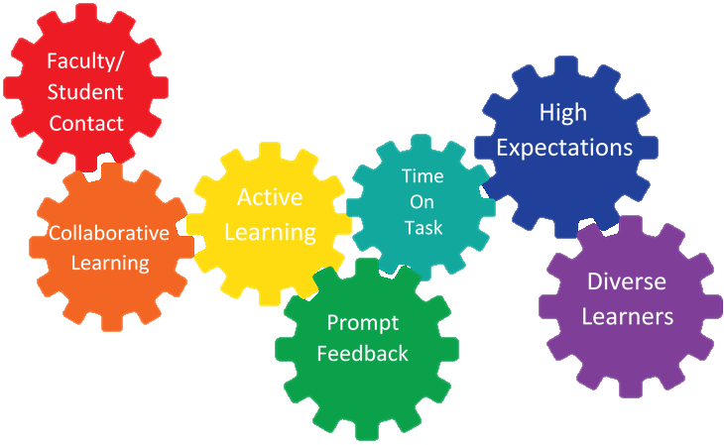
Seven Principles of Good Teaching
Effective strategies that can be implemented in your course; regardless of modality.
Presented by:
Center for Teaching & Learning Excellence

Slide 2
Name a characteristic of a memorable instructor or teacher you have had in the past?
Activity:

Slide 3
As you may have noticed…
Faculty knowledge of learning is critical
Holistic approach – not just about teaching content
We need to understand what our students bring to the learning experience
Notes:
Research-based principles can be applied by ALL faculty to improve Teaching and Learning

Slide 4
Seven Principles for Good Practice
Encourages Faculty/Student Contact
Encourages Student Cooperation
Encourages Active Learning
Gives Prompt Feedback
Emphasizes Time On Task
Communicates High Expectations
Respects Diverse Talents and Ways of Knowing

Slide 5
Activity:
1. With a partner, complete the packet based off the 7 principles listed.
2. When complete, take a Gallery walk around the room and contribute 3 ideas to any principle chart.

Slide 6
1. Encourage contact between students and faculty
Frequent student-faculty contact in and out of classes is the most important factor in student motivation and involvement. Faculty concern helps students get through rough times and keep on working. Knowing a few faculty members well enhances students' intellectual commitment and encourages them to think about their own values and future plans.

Slide 7
1. Encourage contact between students and faculty
In-Person
Establish guidelines in syllabus as to how your students should communicate with you
Office hours
Set clear standards for responding to messages
Online
Create a welcome video
Learning Plan overview videos
Icebreaker and Q & A Discussion board
Higher-level DB questions
Provide instructor biography
Students post picture or video introduction
Blackboard Collaborate
Add profile picture

Slide 8
2. Develop reciprocity and cooperation among students
Learning is enhanced when it is more like a team effort that a solo race. Good learning, like good work, is collaborative and social, not competitive and isolated. Working with others often increases involvement in learning. Sharing one's own ideas and responding to others' reactions sharpens thinking and deepens understanding.

Slide 9
2. Develop reciprocity and cooperation among students
In-Person
Required class participation
Instructor should be clear on expectations
Group projects, collaboration
Self and Peer Reviews (online too)
Online
Required participation in Discussion boards
Learners should received feedback on their discussions
Evaluation should be based on quality (not length in number)
Instructors should post clear expectations

Slide 10
3. Encourage active learning
Learning is not a spectator sport. Students do not learn much just by sitting in classes listening to teachers, memorizing pre-packaged assignments, and spitting out answers. They must talk about what they are learning, write about it, relate it to past experiences and apply it to their daily lives. They must make what they learn part of themselves.

Slide 11
3. Encourage active learning
In-Person
Learner-Centered
Discussion
Scenarios
Role-play
Debate
Online
Discussion
Case studies
Simulations
Game-based reviews
Research
Contribute

Slide 12
4. Give prompt feedback
Knowing what you know and don't know focuses learning. Students need appropriate feedback on performance to benefit from courses. When getting started, students need help in assessing existing knowledge and competence. In classes, students need frequent opportunities to perform and receive suggestions for improvement. At various points during college, and at the end, students need chances to reflect on what they have learned, what they still need to know, and how to assess themselves.
Information Feedback:
Provides information or evaluation, such as an answer to a question or an assignment grade with comments
Acknowledgement Feedback:
Confirms an event occurred. Example: sending an email acknowledging that he or she has received a question or email and that you will respond.

Slide 13
4. Give prompt feedback
In-Person
Check-ins
Quick chats
Prompt grading
Provide positive & corrective feedback
Online
Students receive feedback on grades
Feedback through discussions (peers/facilitator)
Weekly announcements
Virtual check-ins
Bb allows for built-in feedback on tests

Slide 14
5. Emphasize time on task
Time plus energy equals learning. There is no substitute for time on task. Learning to use one's time well is critical for students and professionals alike. Students need help in learning effective time management. Allocating realistic amounts of time means effective learning for students and effective teaching for faculty. How an institution defines time expectations for students, faculty, administrators, and other professional staff can establish the basis of high performance for all.

Slide 15
5. Emphasize time on task
In-Person
Course schedule
Objectives/Agenda for the day
Online
Estimate times for completion (VC)
Course schedule

Slide 16
6. Communicate high expectations
Expect more and you will get more. High expectations are important for everyone -- for the poorly prepared, for those unwilling to exert themselves, and for the bright and well motivated. Expecting students to perform well becomes a self-fulfilling prophecy when teachers and institutions hold high expectations for themselves and make extra efforts.
Notes:
Setting high expectation for students lead them to put forth a higher level of effort. Low expectation or clarity of instructors leads to low motivation in your learners.

Slide 17
6. Communicate high expectations
In-Person
Lay out expectations in syllabus
Clear grading guidelines
Give challenging assignments
Provide examples to follow
Publicly praise exemplary work
Online
Clarity of assignments, rubrics/scoring
Acknowledge students doing great work.
Syllabus quiz

Slide 18
7. Respect diverse talents and ways of learning
There are many roads to learning. People bring different talents and styles of learning to college. Brilliant students in the room may be all thumbs in the lab or studio. Students rich in hands-on experience may not do so well with theory. Students need the opportunity to show their talents and learn in ways that work for them. Then they can be pushed to learn in new ways that do not come so easily.

Slide 19
7. Respect diverse talents and ways of learning
There are many roads to learning. People bring different talents and styles of learning to college. Brilliant students in the room may be all thumbs in the lab or studio. Students rich in hands-on experience may not do so well with theory. Students need the opportunity to show their talents and learn in ways that work for them. Then they can be pushed to learn in new ways that do not come so easily.

Slide 20
7. Respect diverse talents and ways of learning
In-Person and Online
Universal Design for Learning
Set guidelines but allow for choice in projects
Let students guide their own learning
Acknowledge students from various backgrounds, culture and ages

Slide 21
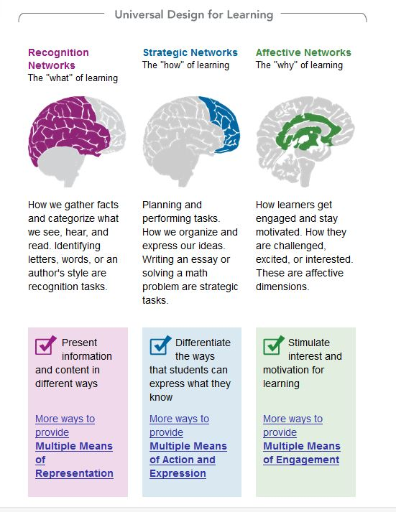
Universal Design for Learning
Set of principles for curriculum development that give all individuals equal opportunity to learn.
These principles are strategic, skillful and goal directed
Goal: Help student become master learners; not master a specific body of knowledge or set of skills.

Slide 22
